Slide 1

SmartTravel
An Intelligent Travel Planning and Recommendation System
Sethu Kruthin Nagari
Sai Venkata Subhash Vakkalagadda

Slide 2

Smart Travel Agent
Purpose: The Smart Travel project aims to simplify and automate holiday planning by using artificial intelligence to develop individualized travel itineraries. The solution will save consumers time and effort by intelligently automating location research, price comparisons, and bookings.
Goal: Smart Travel's mission is to construct and implement an AI-powered travel advisor that generates comprehensive, bookable holiday itineraries based on a user's budget, travel dates, and preferences. The project seeks to provide accurate, efficient, and user-friendly travel recommendations by combining APIs for flights, hotels, and activities.

Slide 3
Team Members
Sethu Kruthin Nagari nagarisn@mail.uc.edu
Sai Venkata Subhash Vakkalagadda vakkalsh@mail.uc.edu
Advisor: Dr. Nitin Nitin

Slide 4
Project Abstract
  The Smart Travel Agent simplifies trip planning using AI. Users enter travel preferences, and the system generates optimized itineraries including flights, hotels, and activities. It uses NLP to interpret input, integrates with booking APIs, and applies AI for recommendations and budget optimization.

Slide 5

User Stories
As a traveler, I want to enter my budget and travel dates so that I can receive vacation options that fit my financial and time constraints.
As a vacation planner, I want to compare flights, hotels, and activities so that I can book the best possible itinerary within my preferences.
As a frequent flyer, I want to save my favorite destinations so that I can quickly access and plan repeat trips in the future.
As a first-time user, I want to receive personalized recommendations based on my interests so that I can explore destinations suited to my lifestyle.
As a busy professional, I want the system to automatically generate and book a full itinerary so that I can save time and avoid the stress of manual planning.

Slide 6
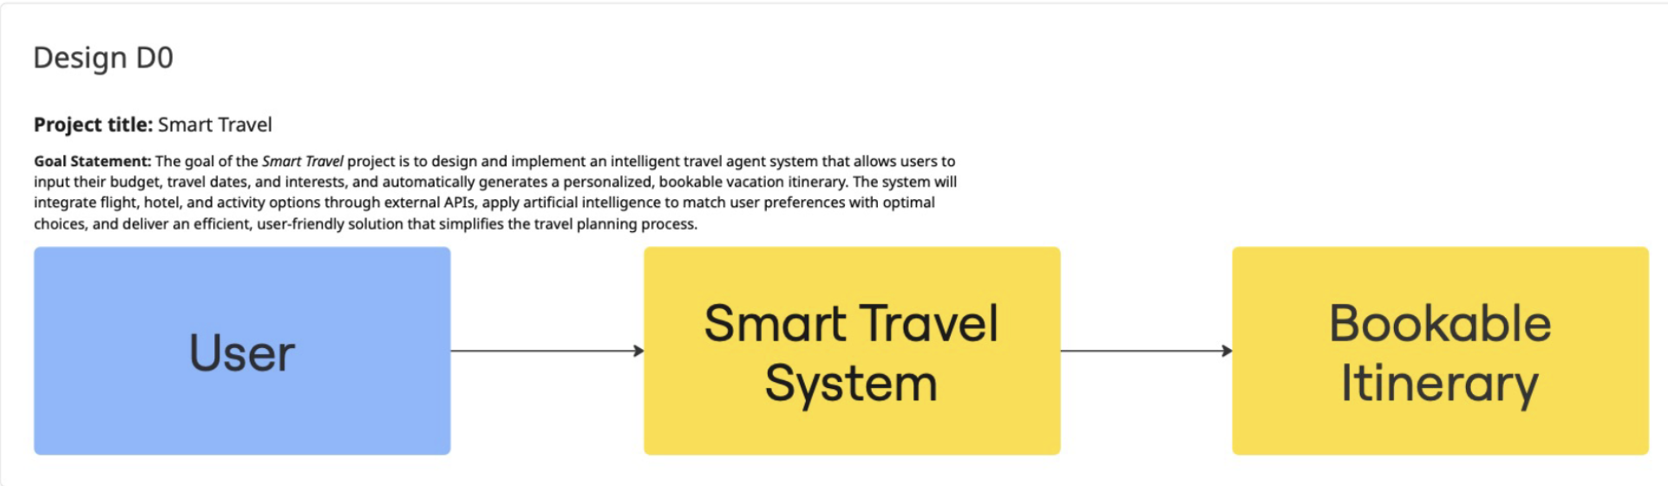
Design Diagrams

Slide 7
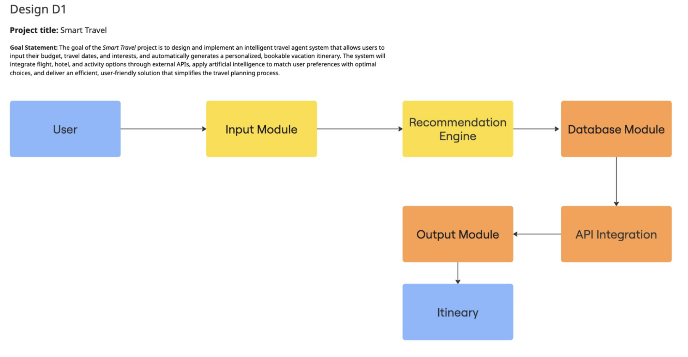
Design Diagrams

Slide 8
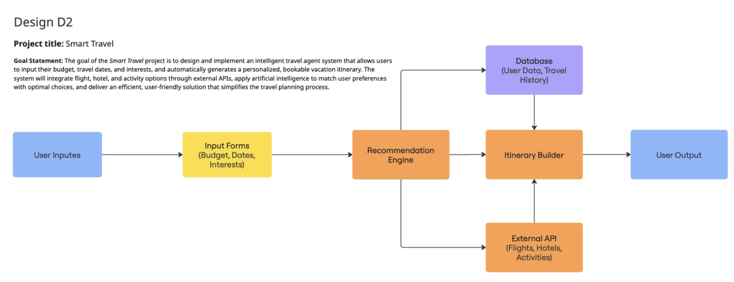
Design Diagrams

Slide 9
Major Project Constraints
Limited budget and development time
Dependency on third-party travel APIs
Data privacy and security concerns
Ensuring real-time response and reliability

Slide 10
Review of Project Progress
Completed requirement gathering and design diagrams
Prototype for itinerary generation completed
Next: Integrate NLP chatbot and real-time booking

Slide 11
Expected Accomplishments
Fully functional AI travel assistant
Seamless API integration
Automated itinerary generation
Web interface for live demo

Slide 12
Division of Work
Sethu Kruthin Nagari – Research, Design & Testing
Researches travel APIs (flights, hotels, activities)
Specifies user requirements (budget, travel dates, interests)
Designs the high-level database schema
Develops the itinerary builder module
Tests the input module for data validation
Refines itinerary builder output (formatting & PDF export)
Documents system modules, workflows, and user instructions

Slide 13
Division of Work
Sai Venkata Subhash Vakkalagadda – Development & Integration
Develops user input forms (budget, date picker, interests)
Implements the database schema and backend connectivity
Designs the AI-based recommendation engine
Integrates flight and hotel booking APIs
Creates database queries for user preferences and travel history
Tests the recommendation engine for accuracy and performance
Validates API integrations through simulated bookings

Slide 14
Expected Demo at Expo
Live demo of Smart Travel Agent
Interactive itinerary generation
AI-driven recommendations and booking simulation

Slide 15
Thank You

